Slide 1

Aim Games Platform
The reference platform for game-making resources
Group 7
Speaker: Mario Bizcocho González
Watch the advertisement!

Slide 2









A great way to get resources!

Slide 3


Contents
What is Aim Games?
Demonstration
Where we are
Team composition
Issues faced
Next steps
Productivity control
Advertisements

Slide 4
Contents
What is Aim Games?
Demonstration
Where we are
Team composition
Issues faced
Next steps
Productivity control
Advertisements

Slide 5
What is Aim Games?
Andalusian Association for the Promotion of Videogames
Provides human and technological resources
Includes experienced professionals

Slide 6
How are we making money?
Government aids
Company membership fees
Sublicensing administrative Access
Development events

Slide 7
Competitor analysis
 | AIM Games | Linkedin | Infojobs | Stratos | Icaro | Primerempleo | Jobrapido | Trabajos.com | Ibereoempleos
Forum | ✓ | ❌ | ❌ | ✓ | ❌ | ❌ | ❌ | ❌ | ❌
Verify CV | ✓ | ❌ | ❌ | ❌ | ❌ | ❌ | ❌ | ❌ | ❌
Share Resources | ✓ | ❌ | ❌ | ✓ | ❌ | ❌ | ❌ | ❌ | ❌
Direct Messaging | ✓ | ✓ | ❌ | ❌ | ❌ | ❌ | ❌ | ❌ | ❌
Courses | ✓ | ✓ | ✓ | ✓ | ❌ | ✓ | ❌ | ✓ | ✓
Company profiles | ✓ | ❌ | ✓ | ✓ | ✓ | ✓ | € | € | ✓
Sector specific | ✓ | ❌ | ❌ | ✓ | ❌ | ❌ | ❌ | ❌ | ❌
Organises events | ✓ | ❌ | ❌ | ❌ | ❌ | ❌ | ❌ | ❌ | ❌
Can challenge applicants | ✓ | ❌ | ❌ | ❌ | ❌ | ❌ | ❌ | ❌ | ❌
Notes:
AEVI: Asociación Española del Videojuego
STRATOS: offers both job opportunities and collaboration opportunities, the latter do not necessarily involve economical retribution. Also, severe lack of offers in Andalusia. Resembles a forum.
ICARO insecure: GET hacking when editing curricula

Slide 8
Differentiation
Intuitive design
Credibility
Proximity
Collaboration

Slide 9

Version model
www.aim-games-<iteration no>.herokuapp.com
www.aim-games-landing-page.herokuapp.com

Slide 10
Contents
What is Aim Games?
Demonstration
Where we are
Team composition
Issues faced
Next steps
Productivity control
Advertisements

Slide 11


Google Ads campaign
320€/month
~35000 impressions/month
~1100 clicks/month
Target: 20-40 years old, tech-interested, looking for job-related information

Slide 12
Youtube campaign
6.5 second version of advertisement (English)
Non-skippable
300€/month
~26000 plays/month
Target: 20-40 years old, tech-interested, looking for Unity tutorials/animation tutorials/videogame making
Available here

Slide 13
Targeted advertisements
For more inexpensive media
Version for companies and version for freelancers (English)
~35 seconds
Informal, engaging
Aimed at showing in our association’s activities or as part of bigger events

Slide 14
Advertisement for investors
Business information
Description of income sources and business expandability
Trustworthiness, professionality
Available here

Slide 15
Contents
What is Aim Games?
Demonstration
Where we are
Team composition
Issues faced
Next steps
Productivity control
Advertisements

Slide 16

15

Slide 17
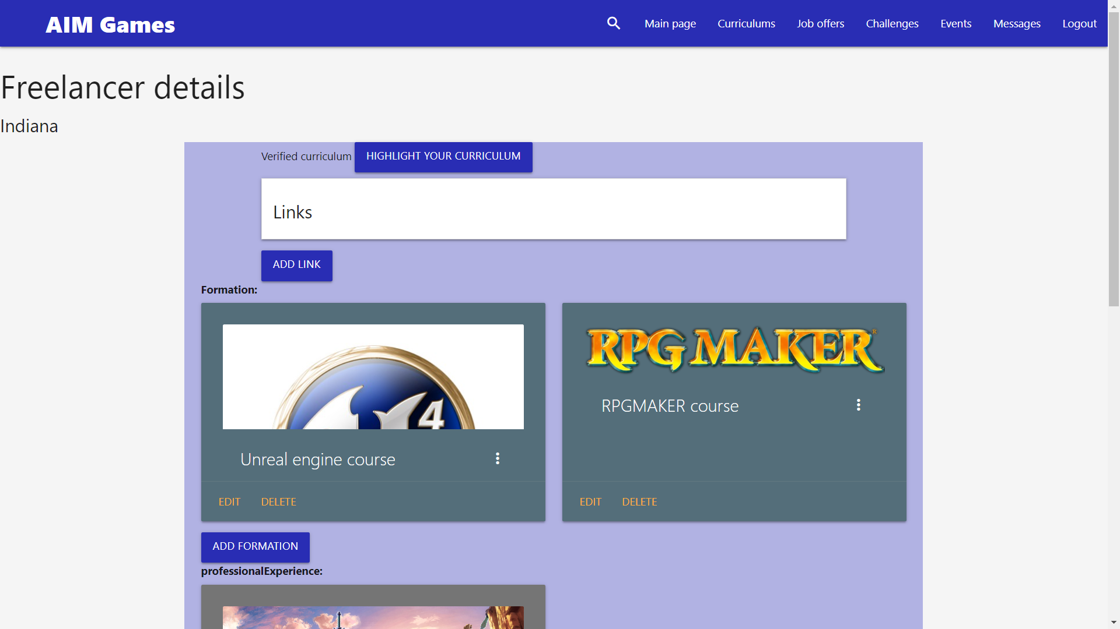
16

Slide 18
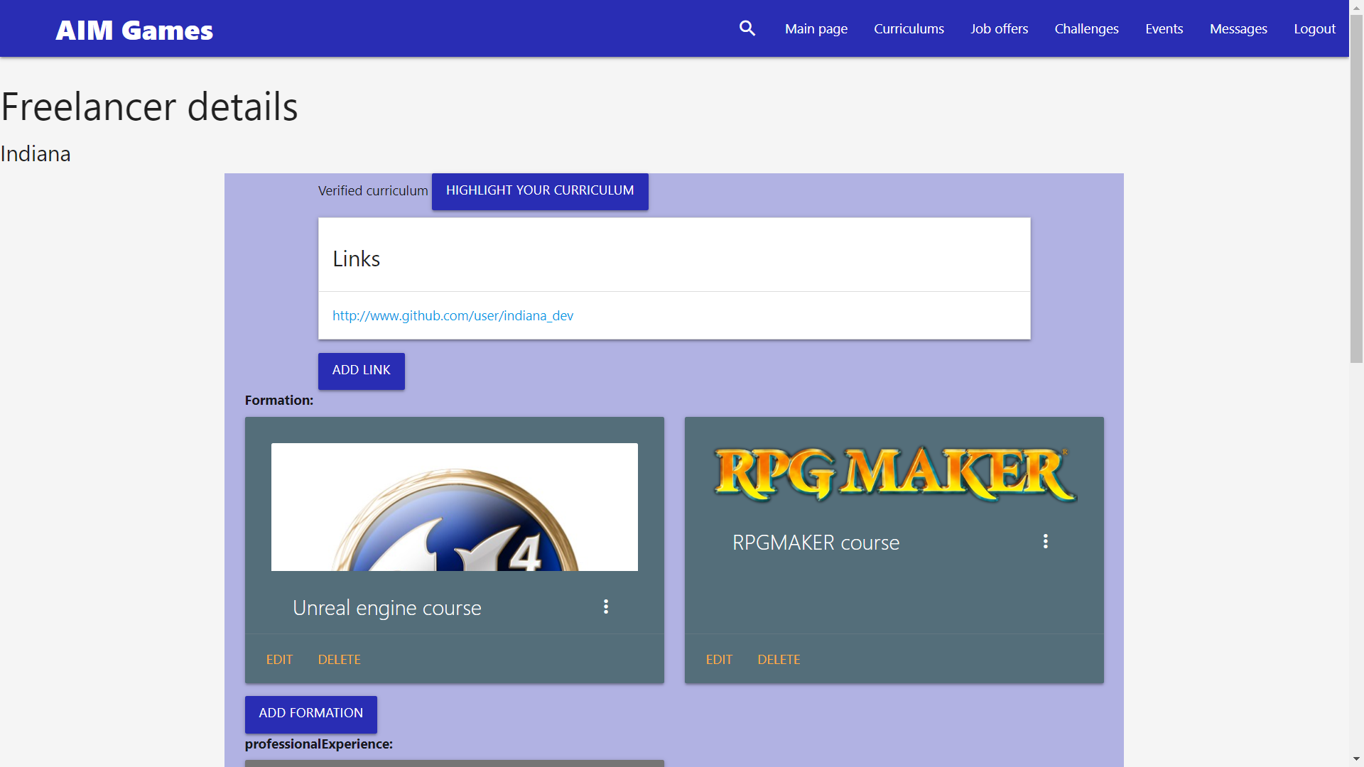
17

Slide 19

18

Slide 20
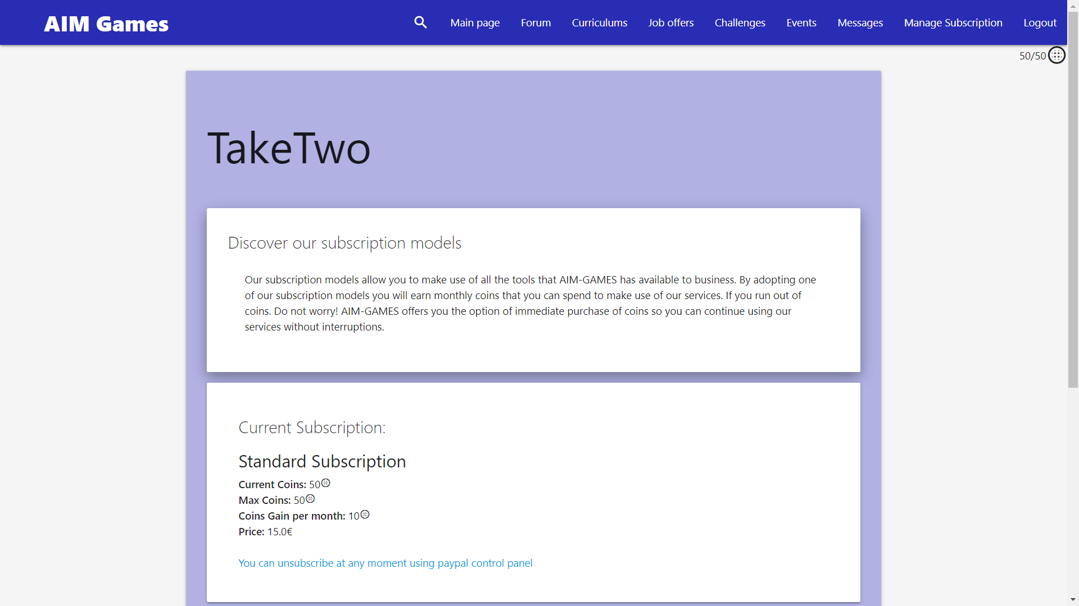
19

Slide 21
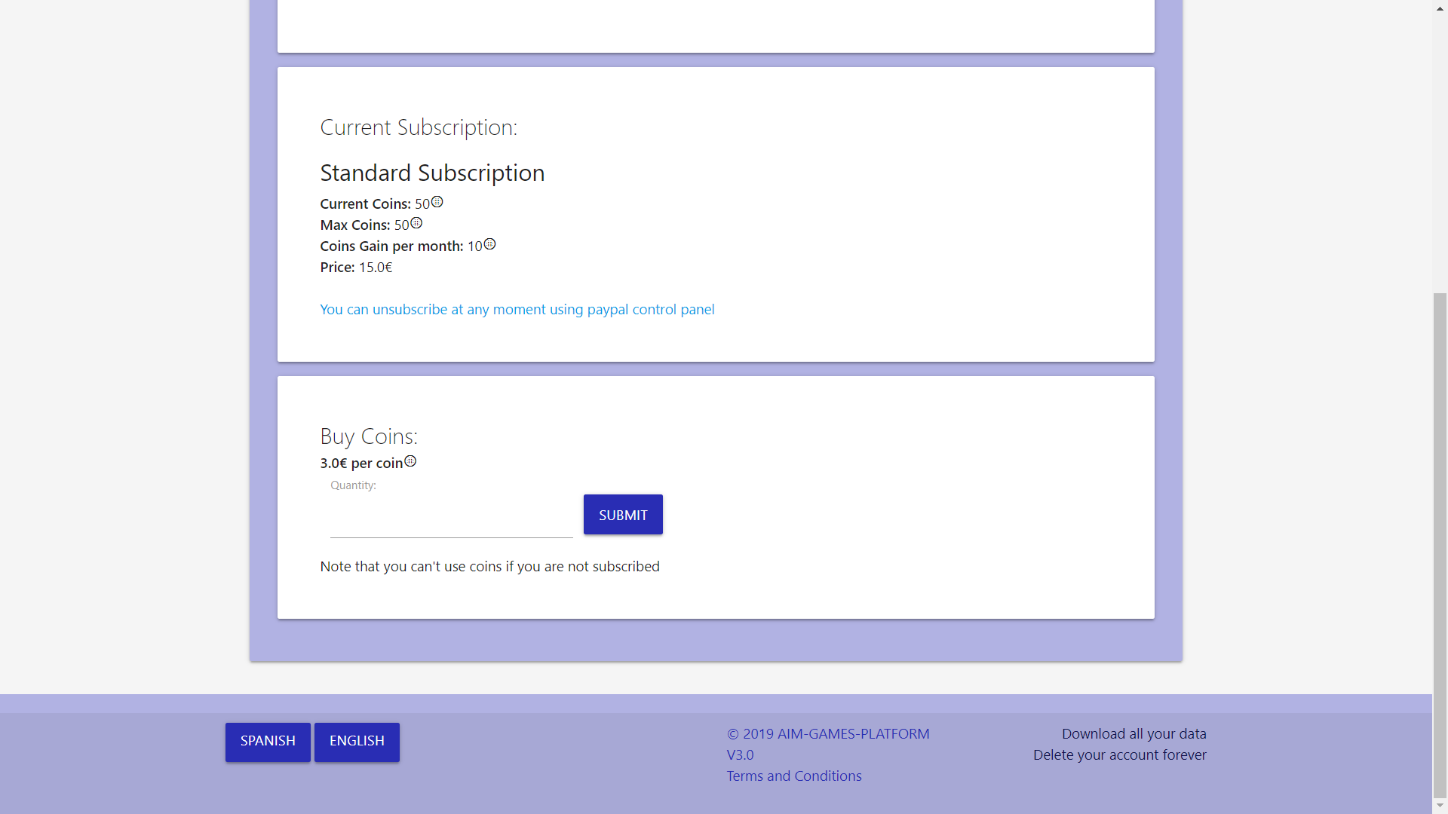
20

Slide 22
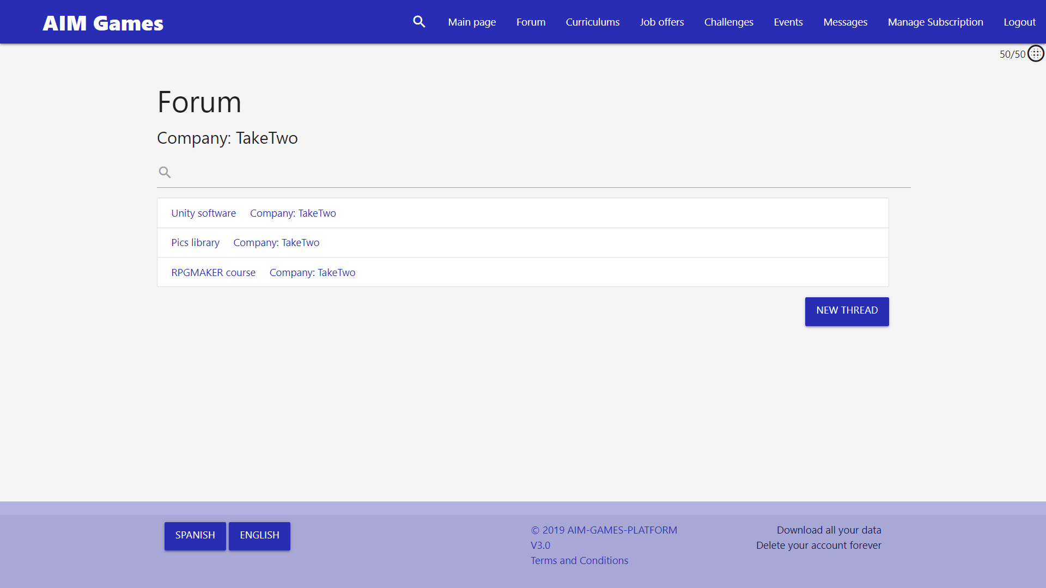
21

Slide 23
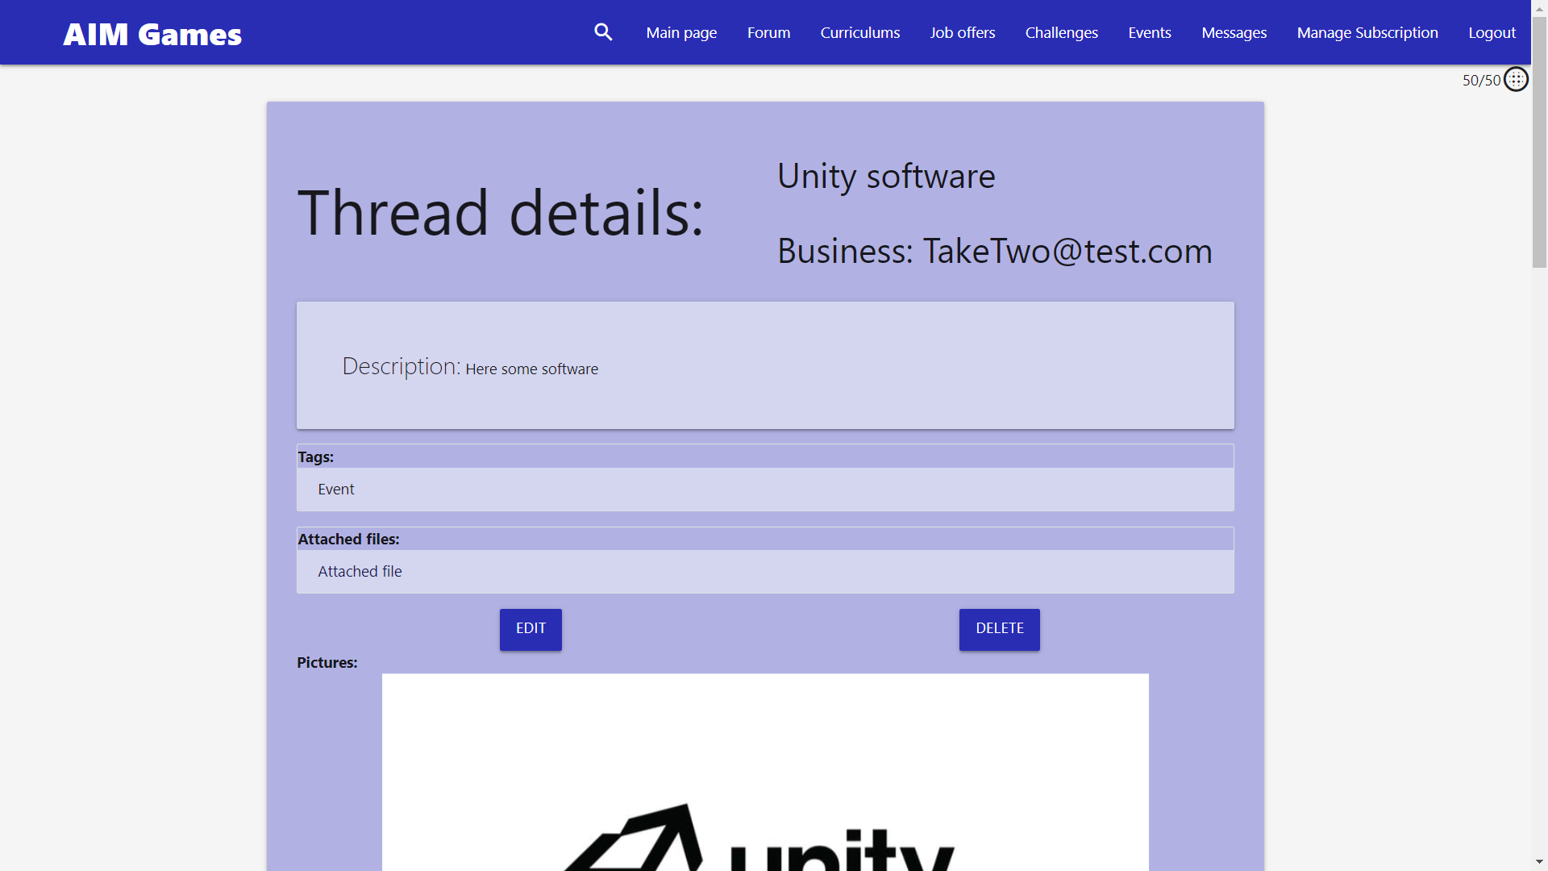
22

Slide 24
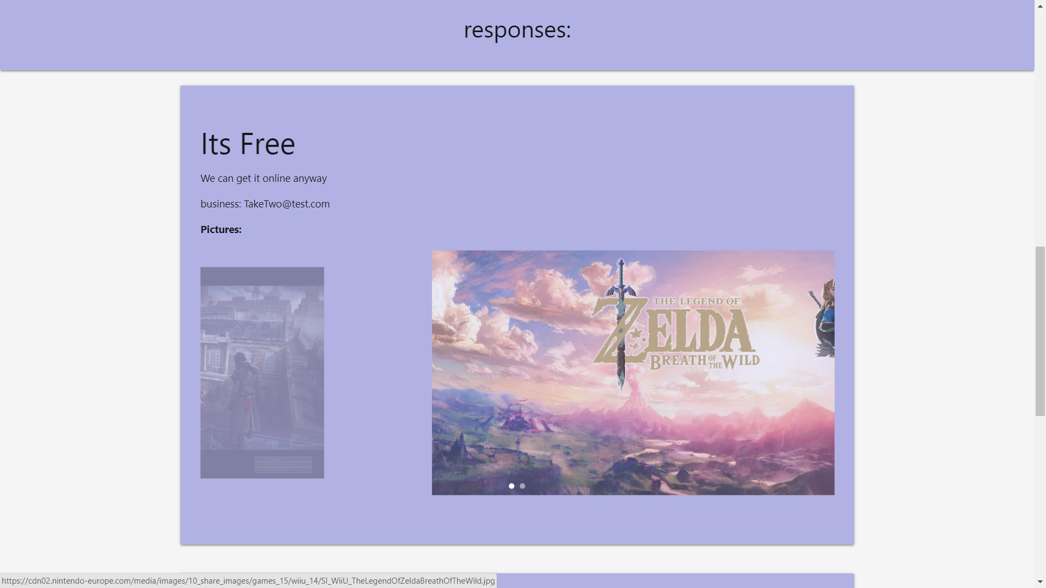
23

Slide 25
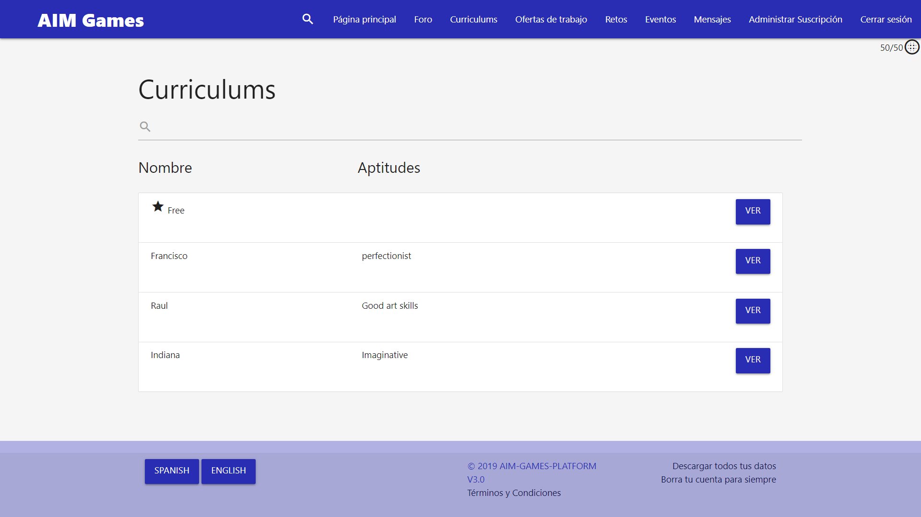
24

Slide 26
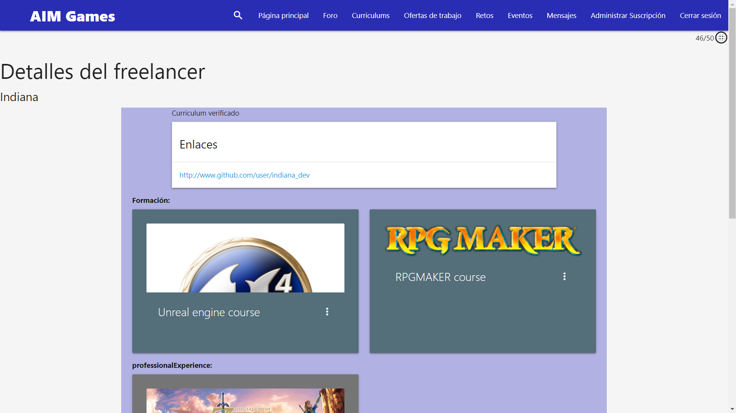
25

Slide 27
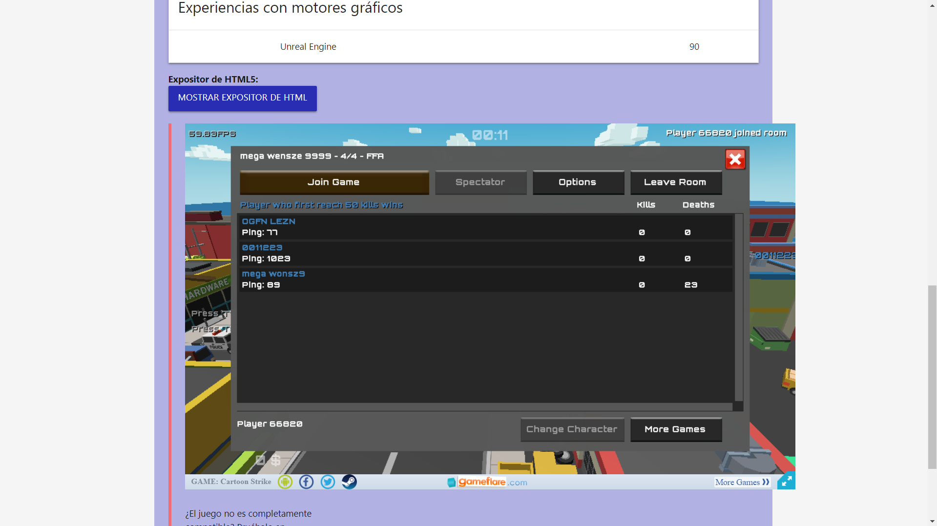
26

Slide 28
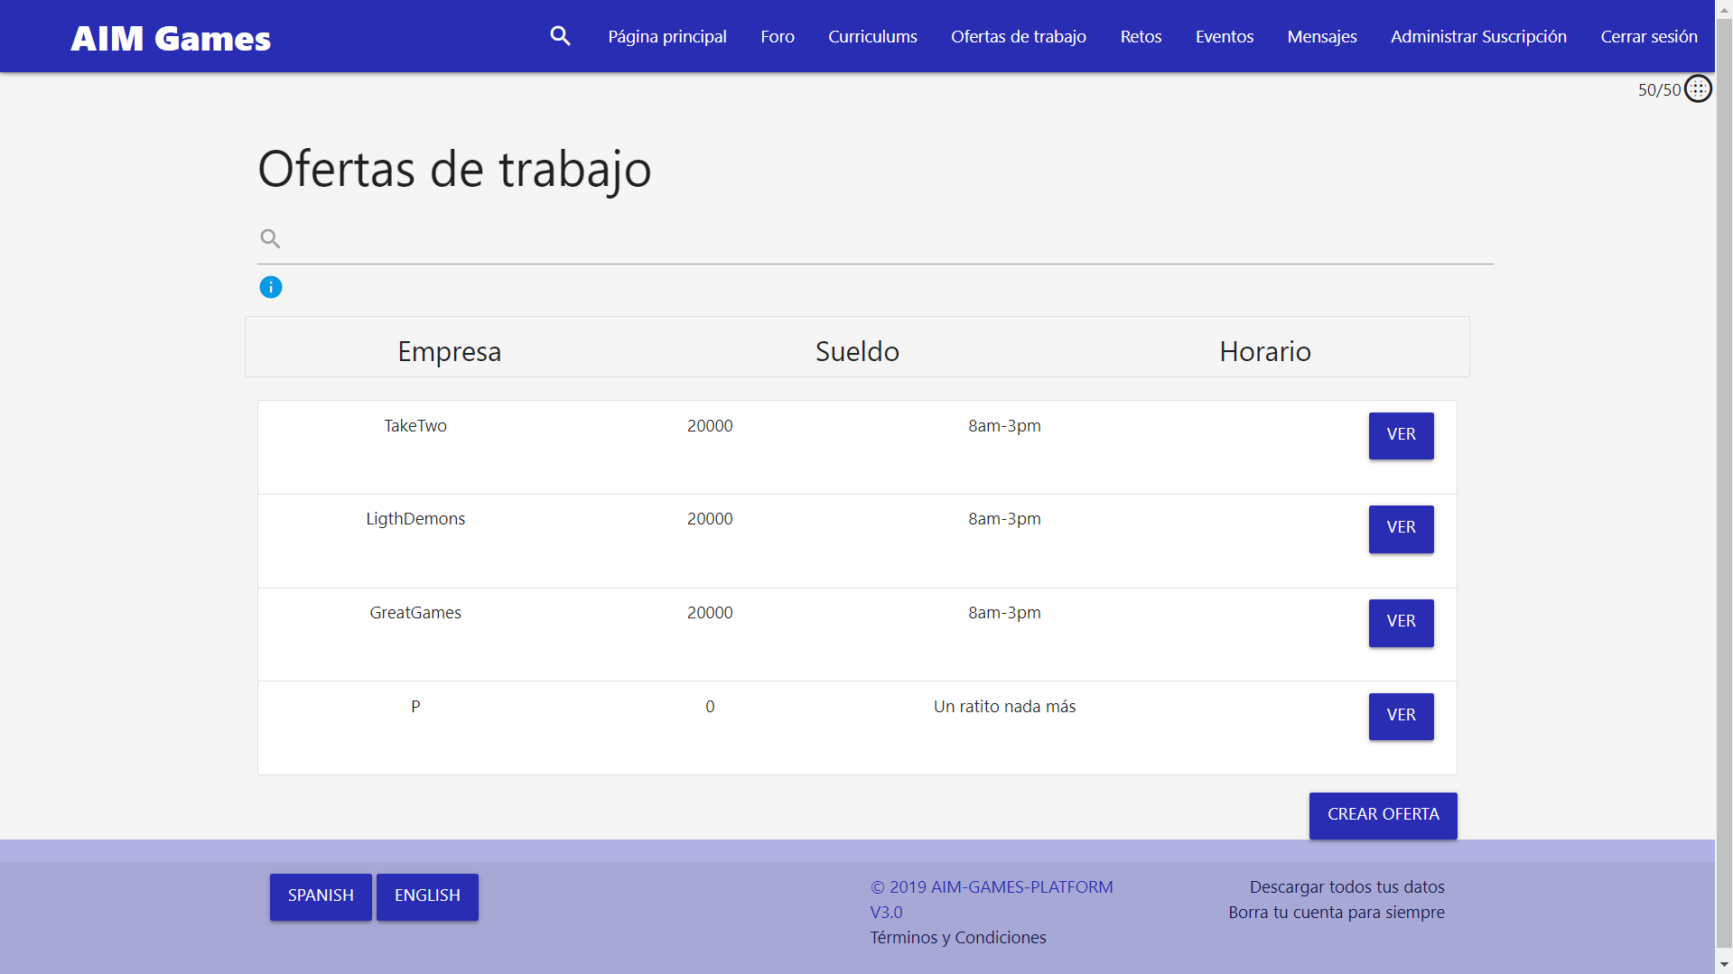
27

Slide 29
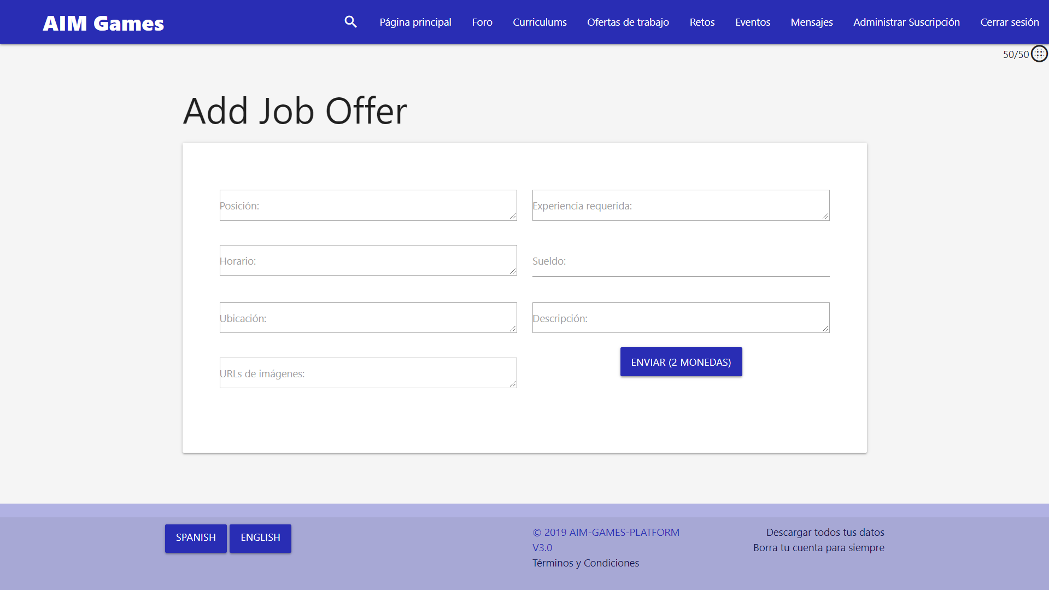
28

Slide 30
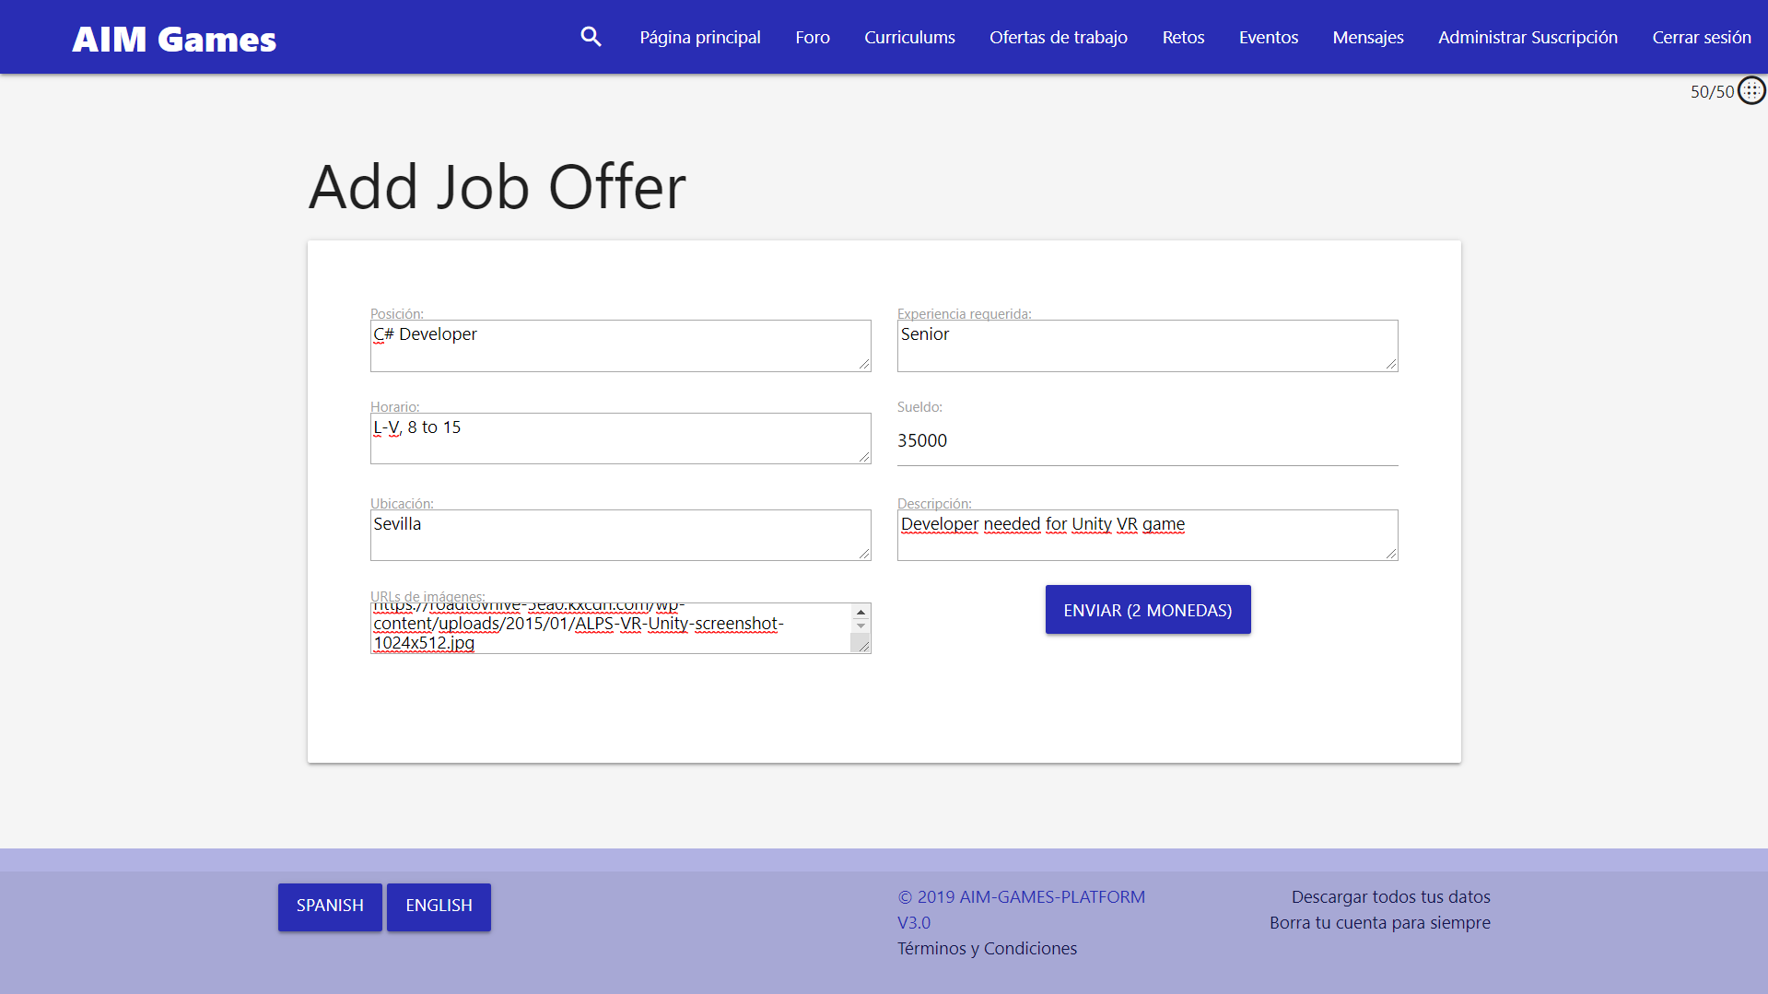
29

Slide 31
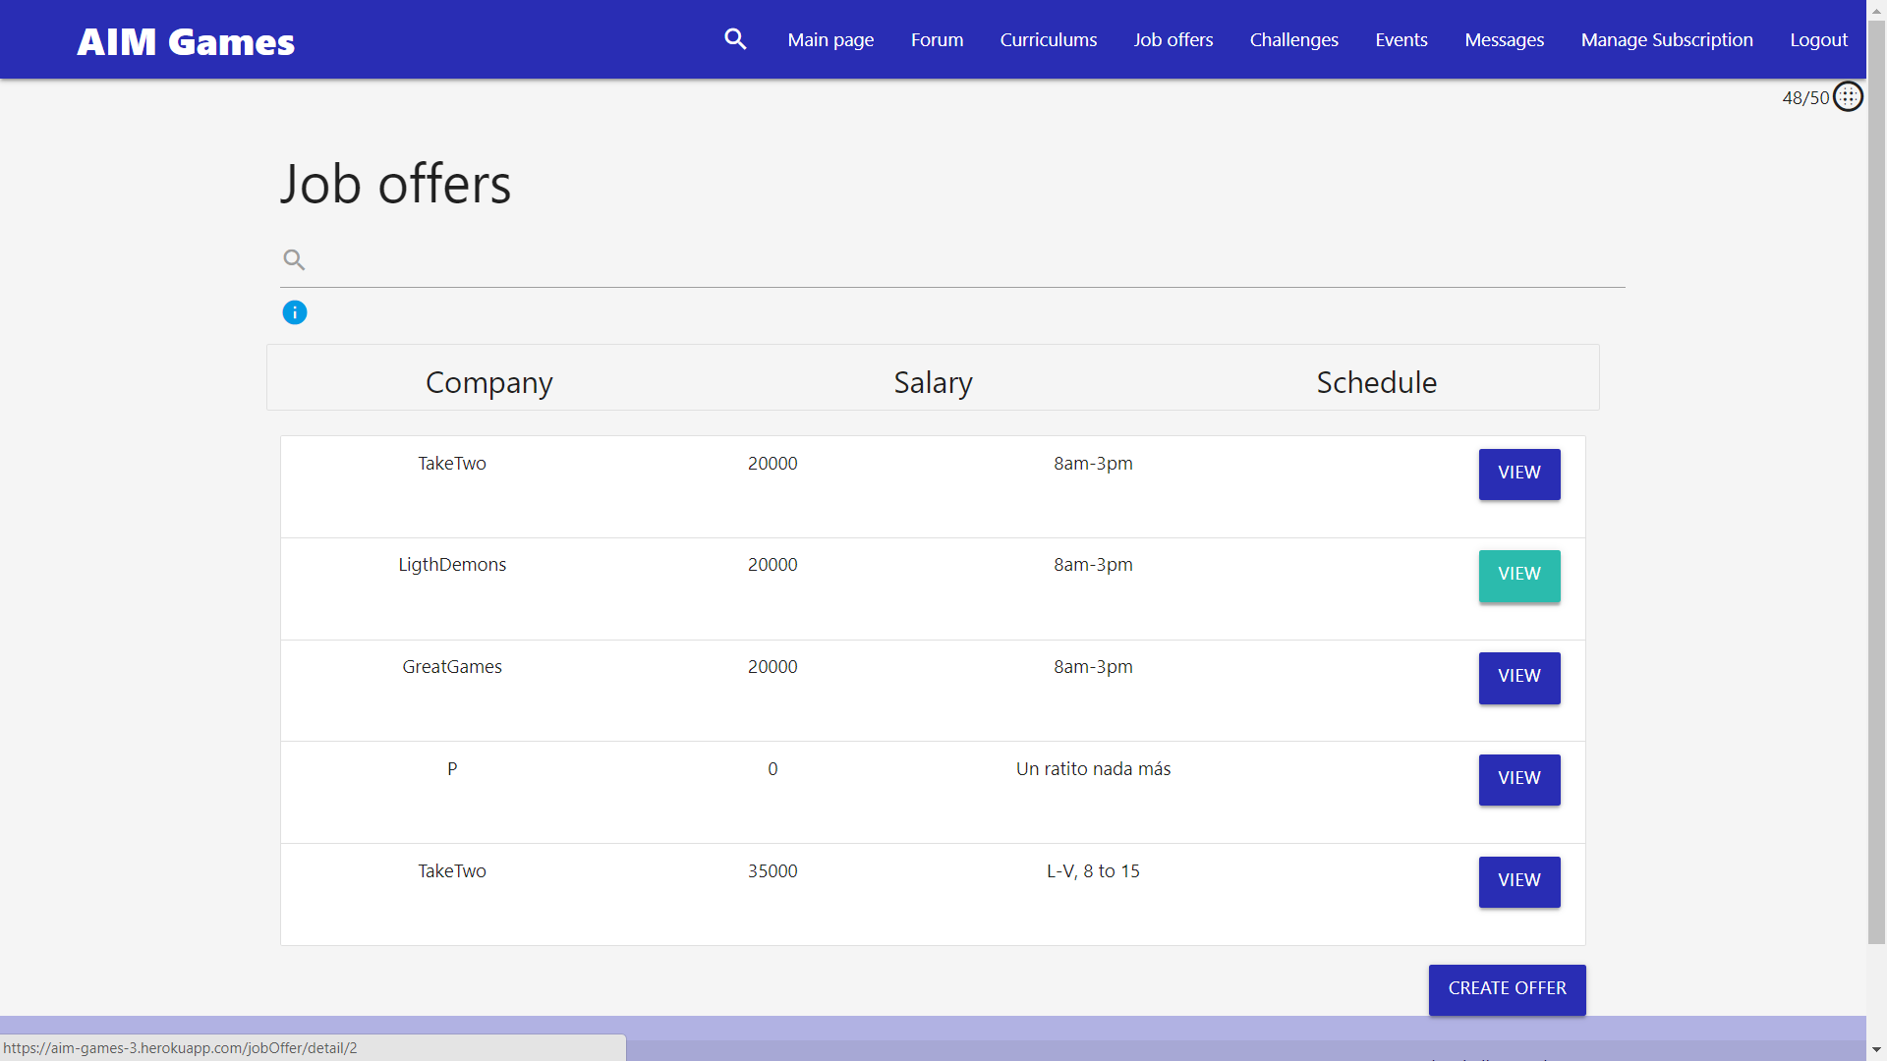
30

Slide 32
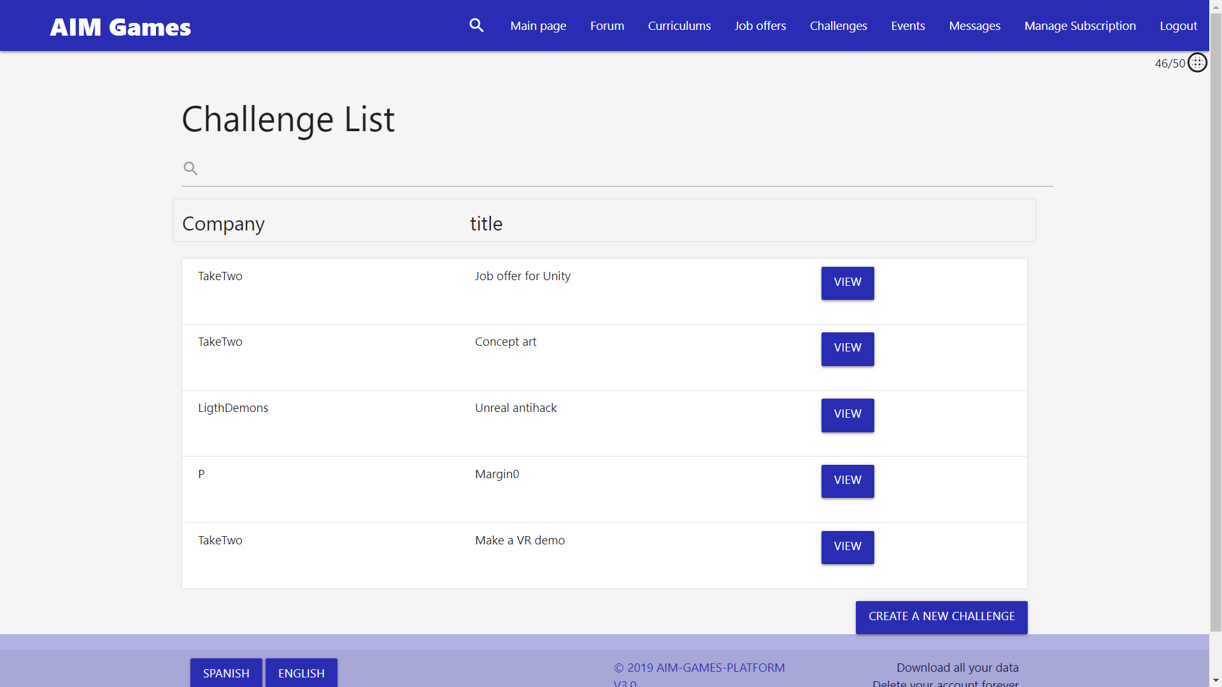
31

Slide 33
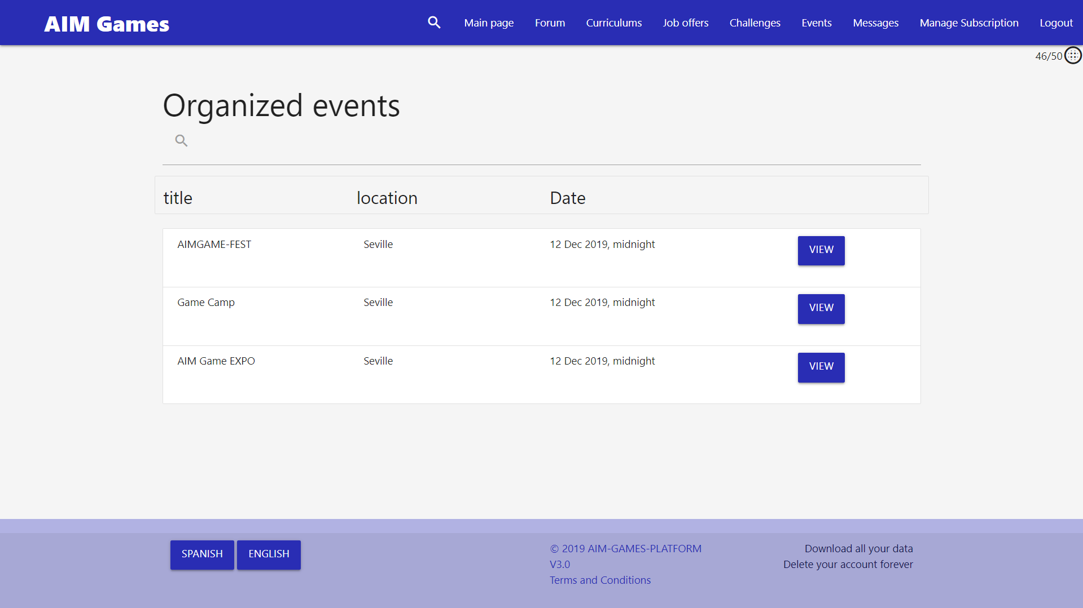
32

Slide 34
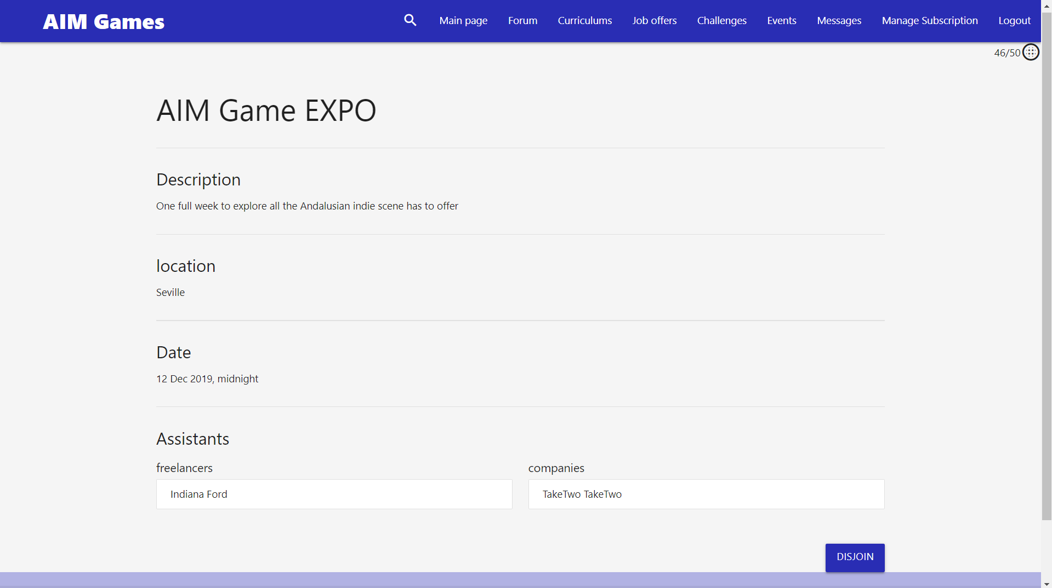
33

Slide 35
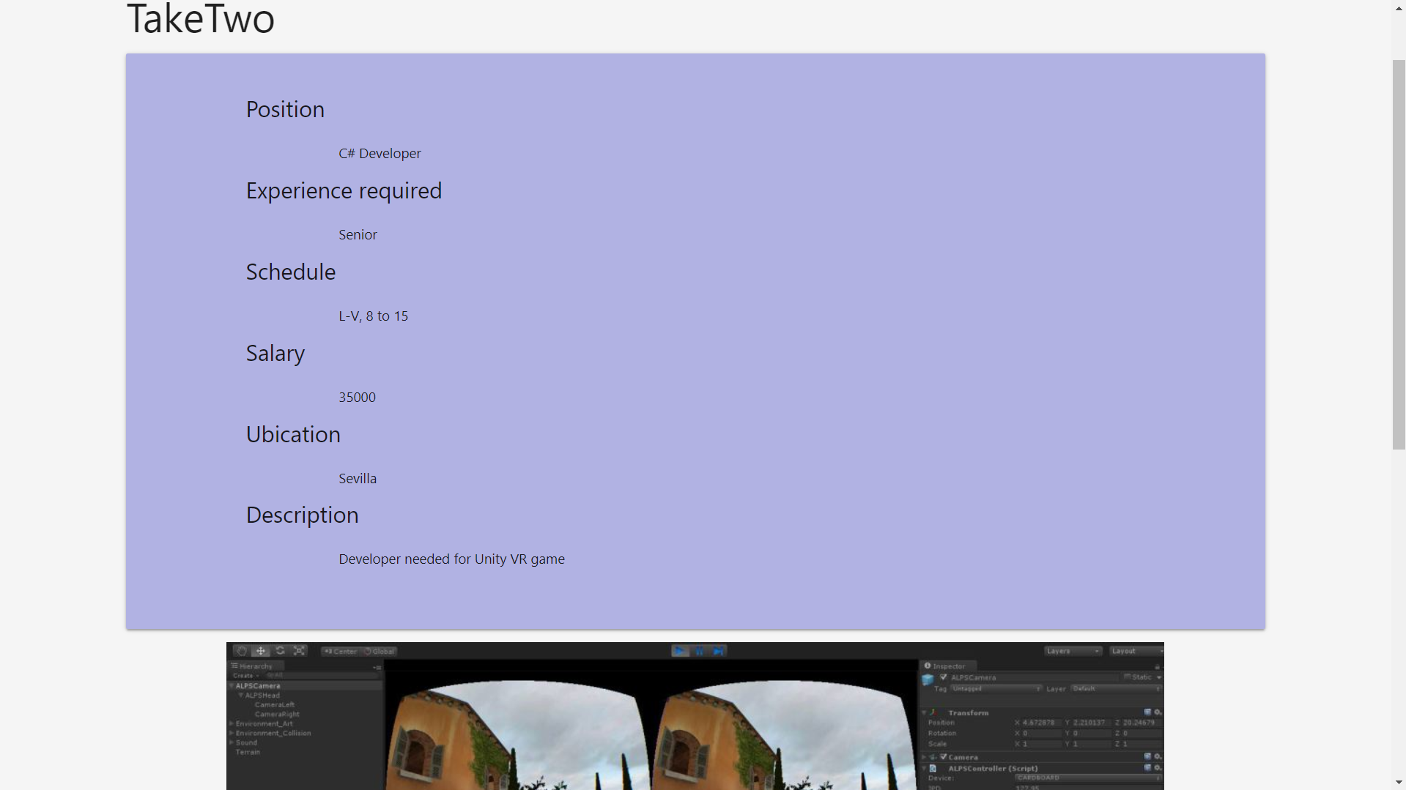
34

Slide 36
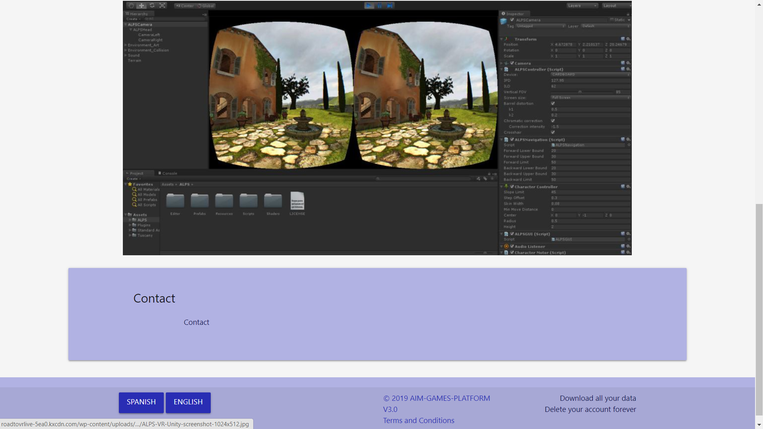
35

Slide 37
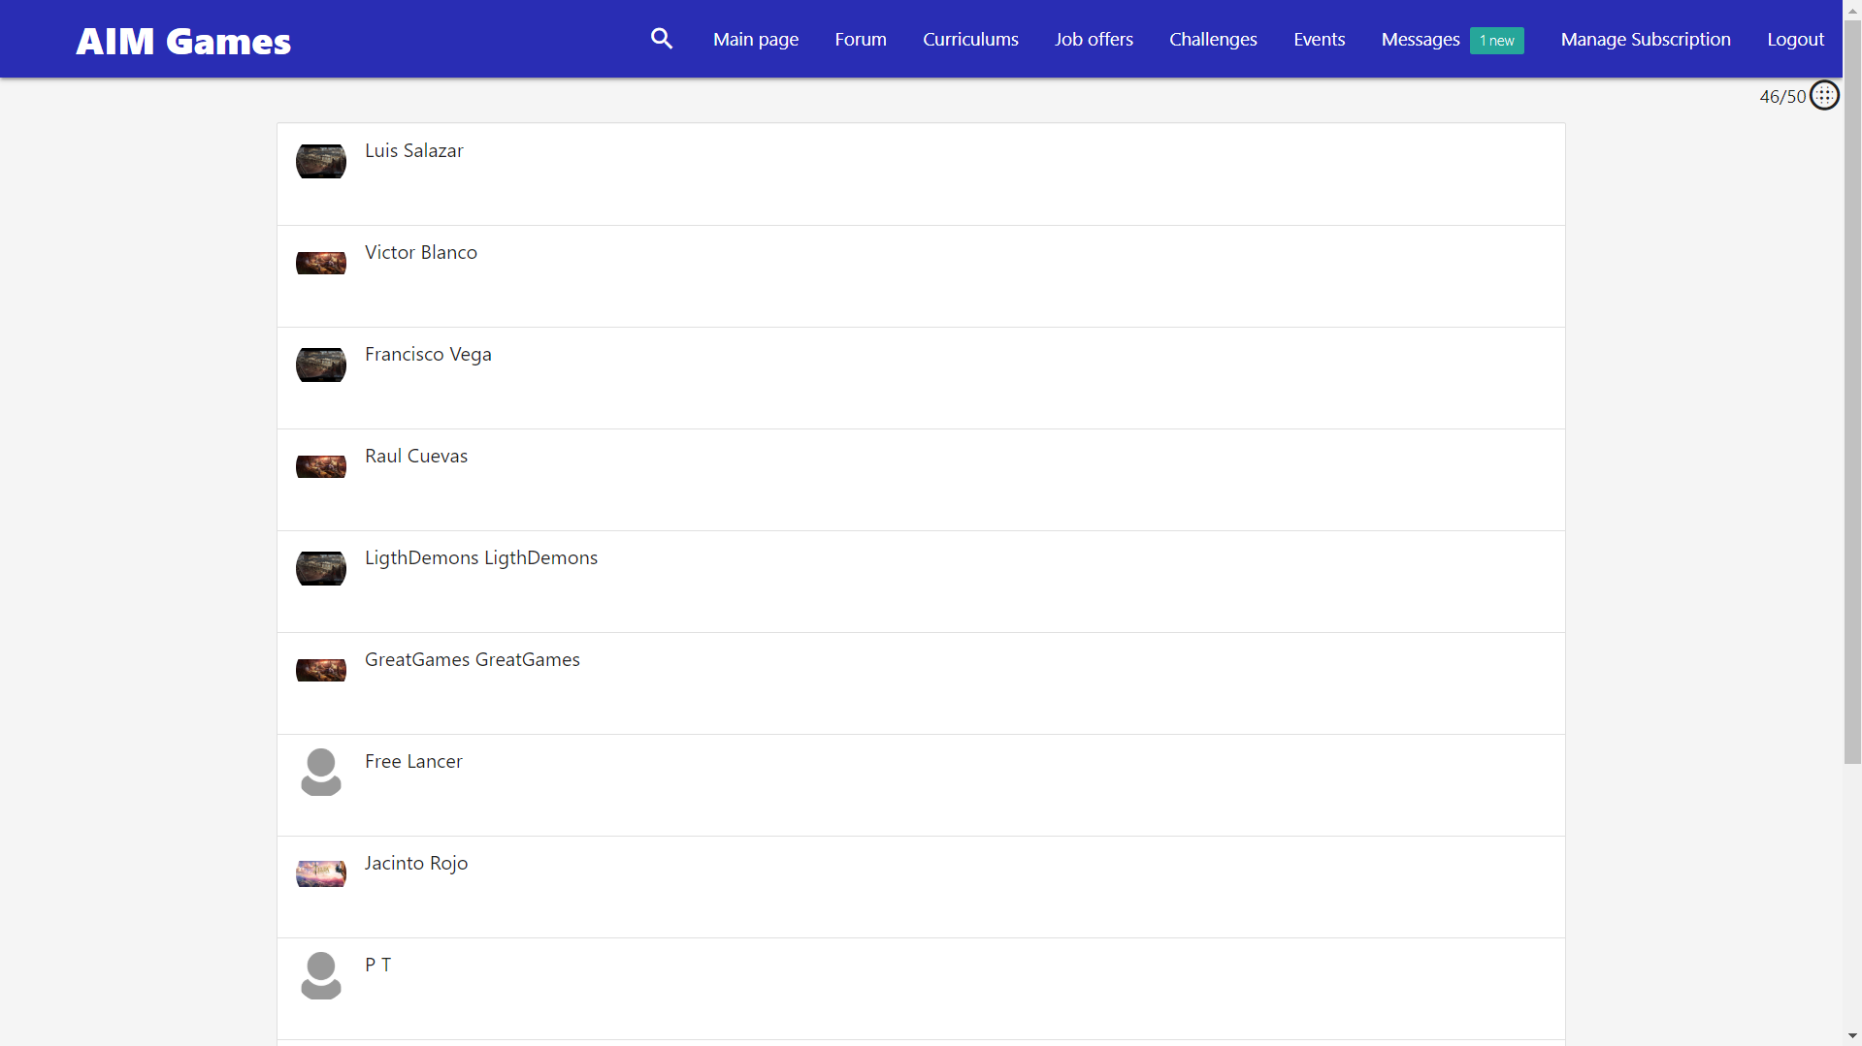
36

Slide 38
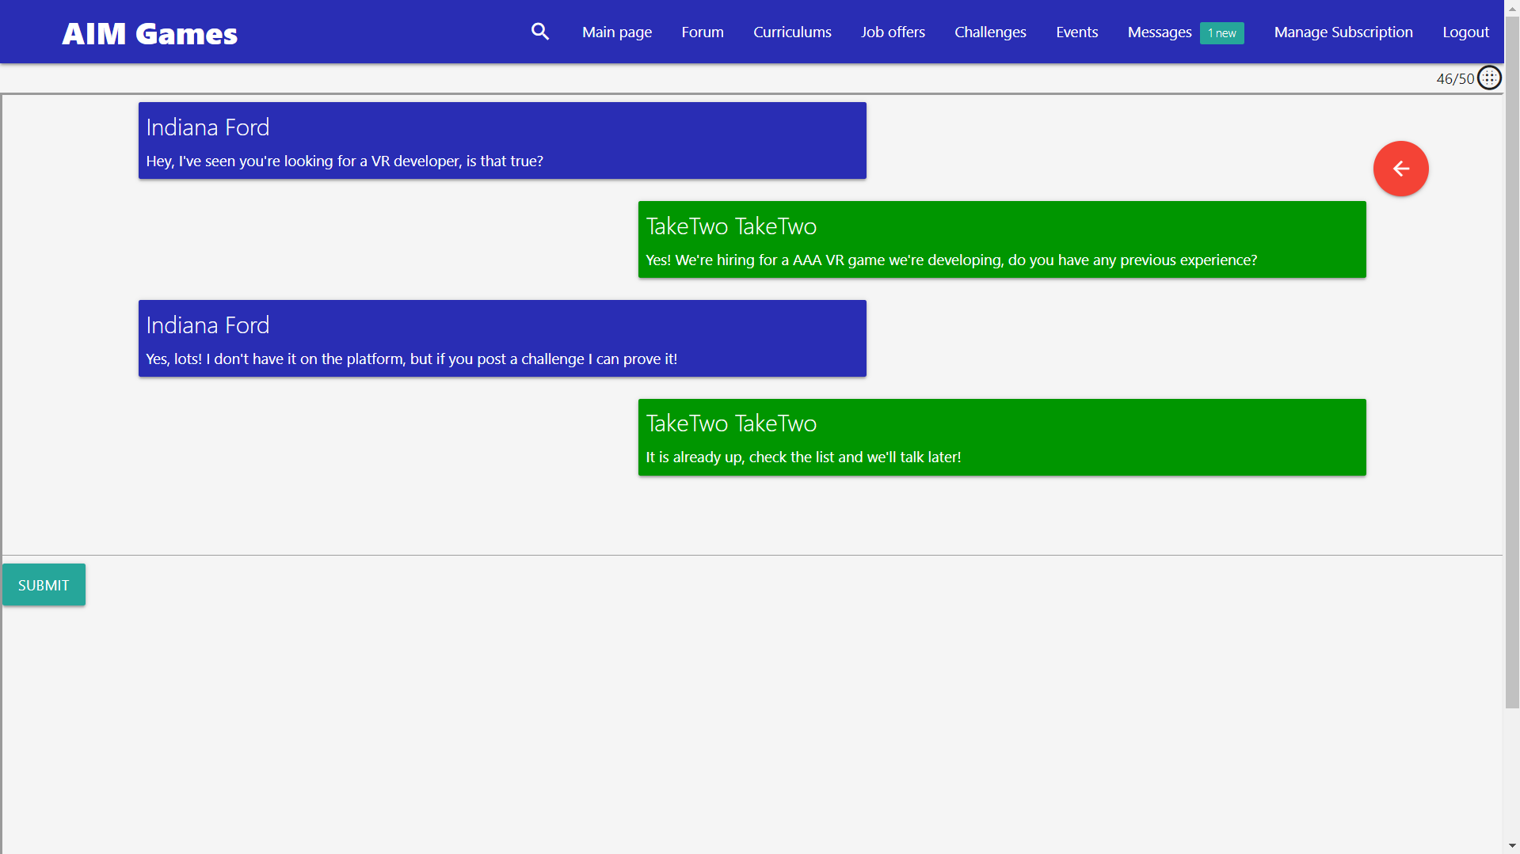
37

Slide 39
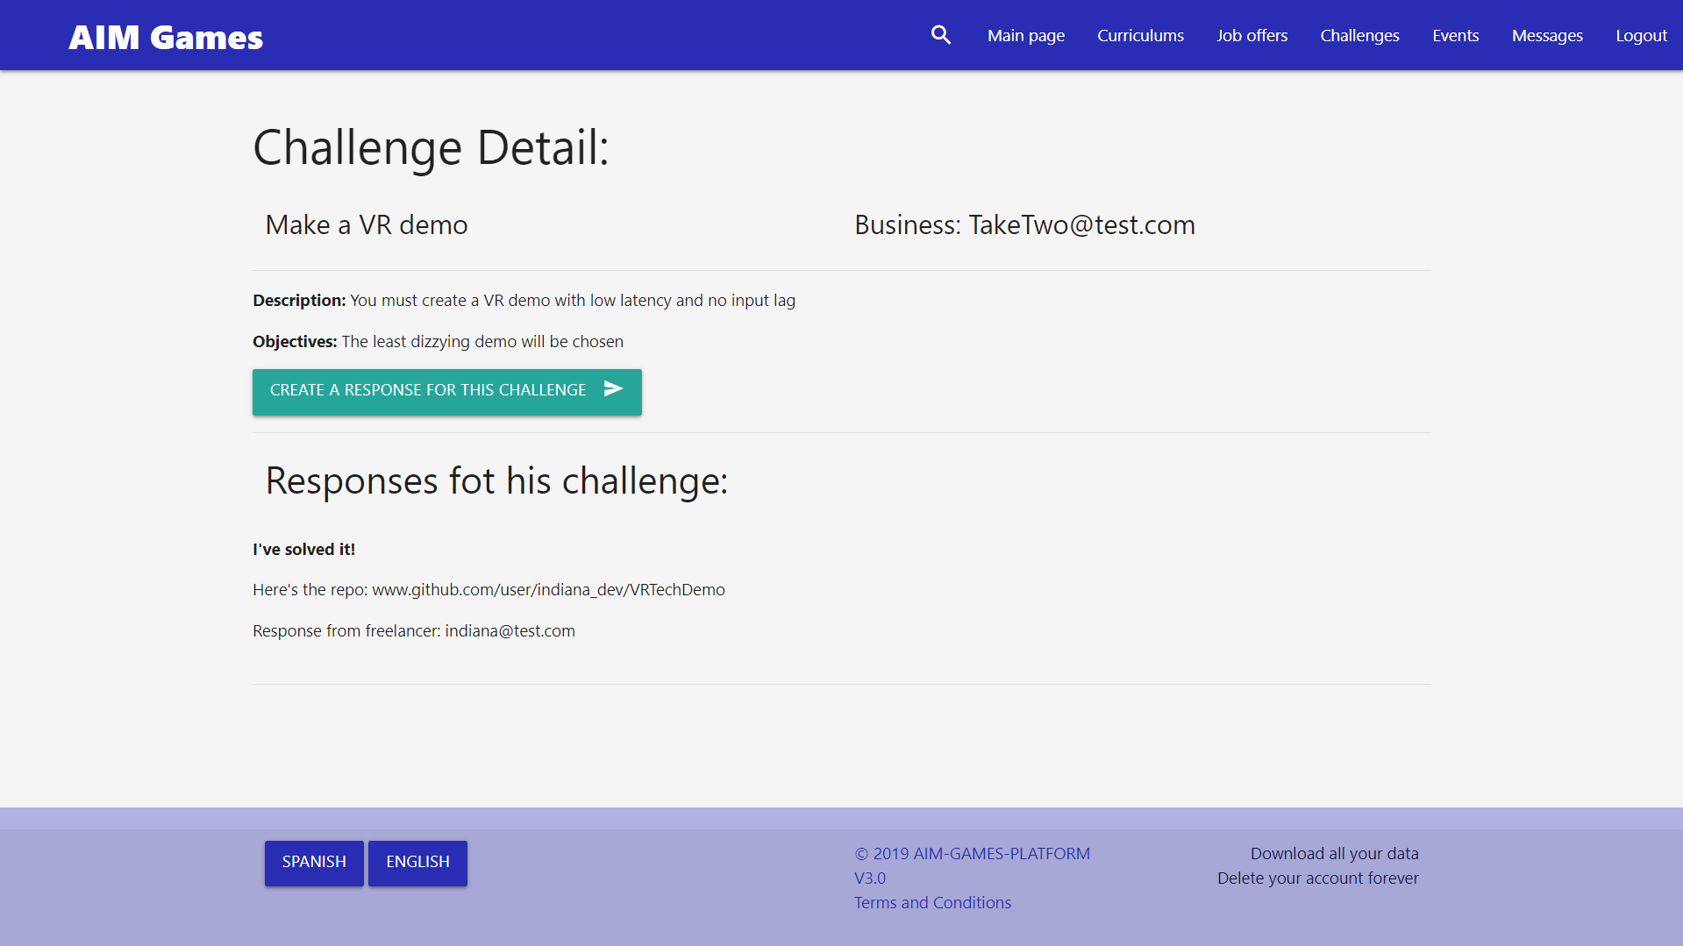
38

Slide 40
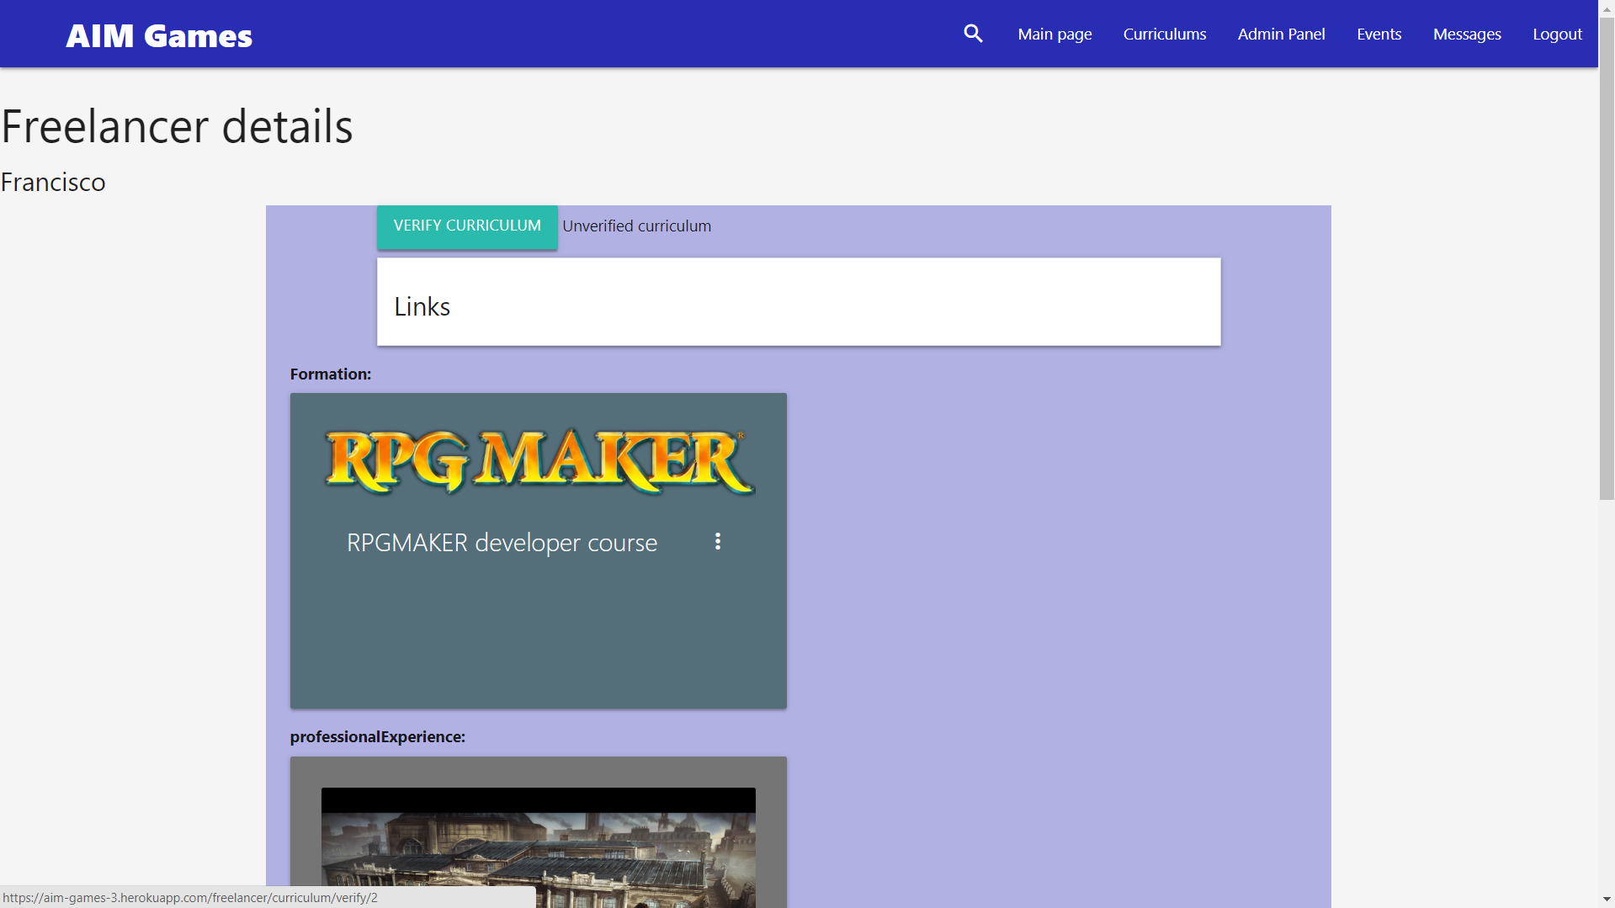
39

Slide 41
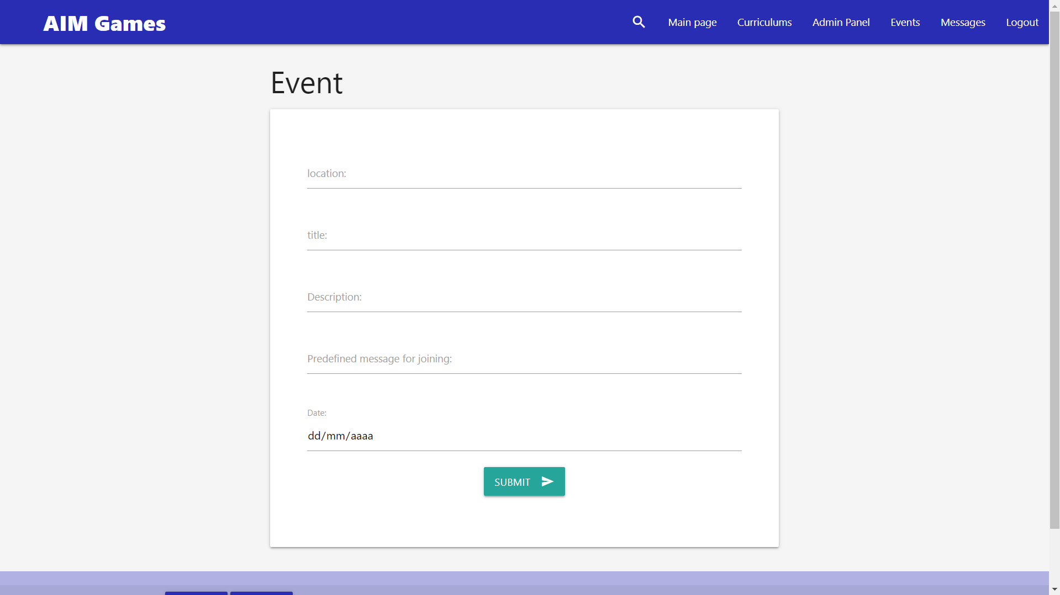
40

Slide 42
Contents
What is Aim Games?
Demonstration
Where we are
Team composition
Issues faced
Next steps
Productivity control
Advertisements

Slide 43
Where we are
Fifth iteration successful
Promotional material made
Currently making advertisements and some final platform tweaks

Slide 44
Where we are
Concept | Net cost
Direct costs (salaries, social costs, others) | €35978.01
Indirect costs | €1497.58
Reserves | €3747.56
Profit | €5621.34
Total before tax | €46844.49
VAT (21%) | €9837.35
Total | €56681.84
Notes:
Capital revenue: regional government aids to associations, company membership fees,

Slide 45
Direct costs

Slide 46
INDirect costs

Slide 47
Where we are
Name | Role | Price/hour | Invested hours | Gross Salary | Social costs | Total
De la Fuente Bonilla, Fco. Javier | CEO, Project Manager | 25€/h | 150h | 3750€ | 1124.63€ | 4874.63€
Molina Domínguez, Jorge Manuel | CCO, CIO | 22,73€/h | 150h | 3409,5€ | 1022.51€ | 4432.01€
Bizcocho González, Mario | CMO, Speaker | 22,73€/h | 150h | 3409,5€ | 1022.51€ | 4432.01€
Monteseirín Puig, Alejandro | Full-stack Developer | 18,54€/h | 150h | 2781€ | 834.03€ | 3615.03€
Pérez Piñero, Iván | Backend Developer | 15,37€/h | 150h | 2305.5€ | 689.35€ | 2994.85€
Arenas Arenas, Antonio | Frontend Developer | 15,37€/h | 150h | 2305.5€ | 689.35€ | 2994.85€
Santos Batista, Miguel | Full-stack Developer | 18,54€/h | 150h | 2781€ | 834.03€ | 3615.03€
Pazo Jiménez, Pablo | Backend Developer | 15,37€/h | 150h | 2305.5€ | 689.35€ | 2994.85€
 |  |  |  | 23047,5€ | 6905.76€ | 29953,75€
Notes:
Capital revenue: regional government aids to associations, company membership fees,

Slide 48
Where we are

Slide 49
Contents
What is Aim Games?
Demonstration
Where we are
Team composition
Issues faced
Next steps
Productivity control
Advertisements

Slide 50
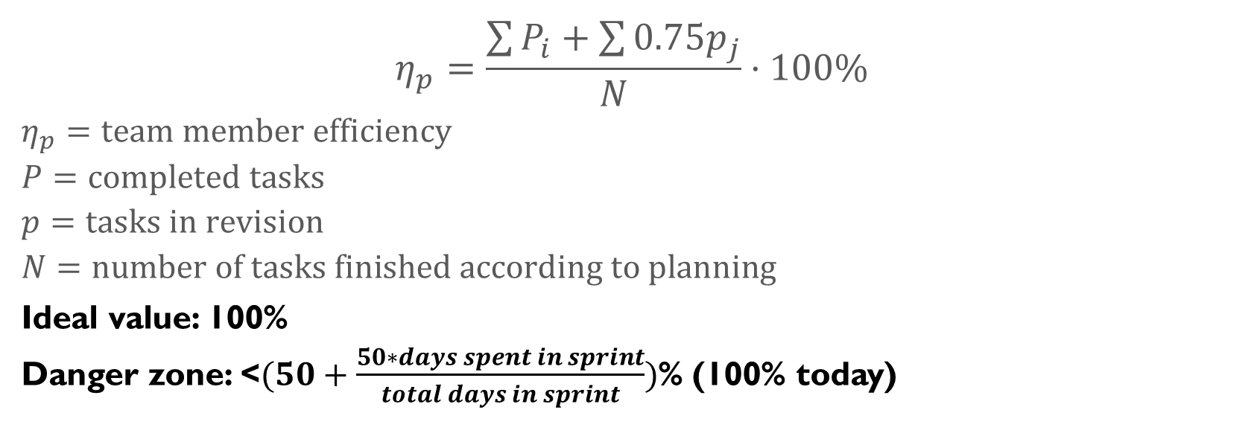
Productivity plan
$$η_{p}=\frac{\sum{P_{i}}+\sum{{0.75p}_{j}}}{N}·100\%$$
$$η_{p}=team member efficiency$$
$$P=completed tasks$$
$$p=tasks in revision$$
$$N=number of tasks finished according to planning$$
Ideal value: 100%
Danger zone: <$(50+\frac{50∗days spent in sprint}{total days in sprint})$% (100% today)

Slide 51
Punishment strategy
3 warning system
Expulsion at the 3rd warning
Automatic warning for incompletion
Proposed warning (voting)
Pardoning of warning on sprint without incidents

Slide 52
Contents
What is Aim Games?
Demonstration
Where we are
Team composition
Issues faced
Next steps
Productivity control
Advertisements

Slide 53
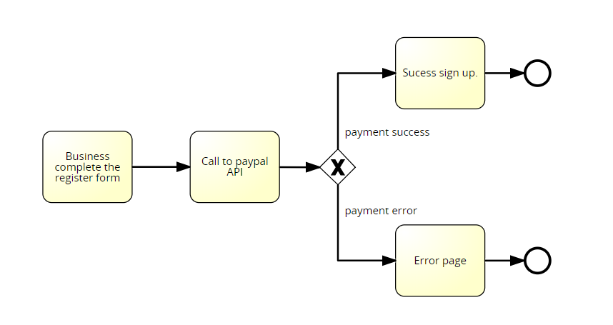






Issues faced
Issue 1: PayPal
Issue 2: Database
Issue 3: Git
Issue 4: Manager role
Issue 5: PPT bug
Issue 6: communication breakdown
Issue 7: PayPal recognition

Slide 54

Issues faced
Issue 8: Video editing suite demo period

Slide 55
Contents
What is Aim Games?
Demonstration
Where we are
Team composition
Issues faced
Next steps
Productivity control
Advertisements

Slide 56

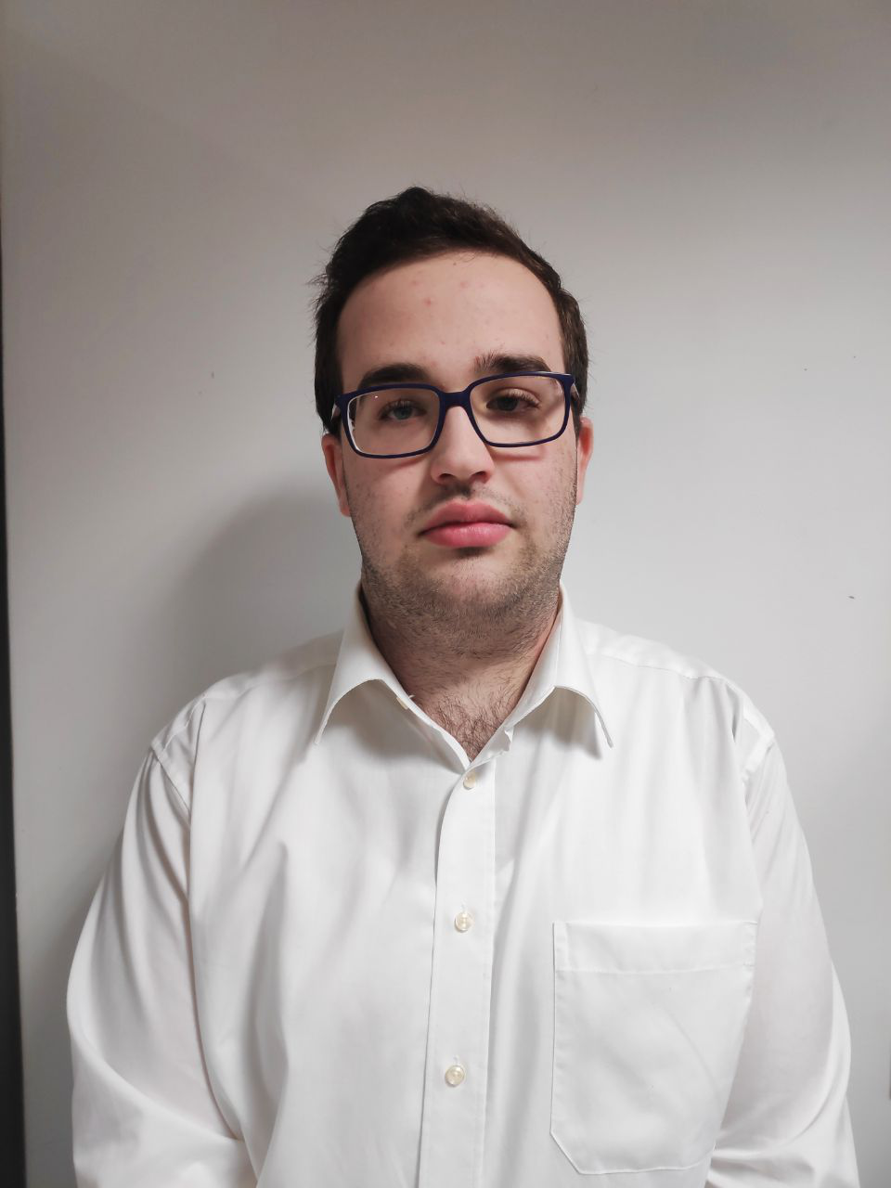
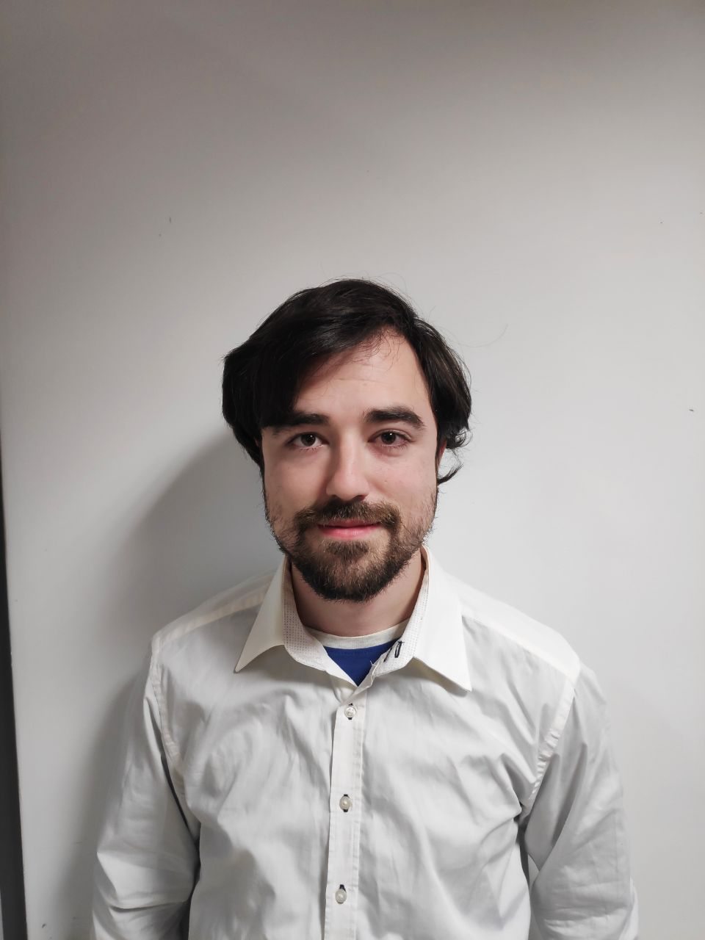
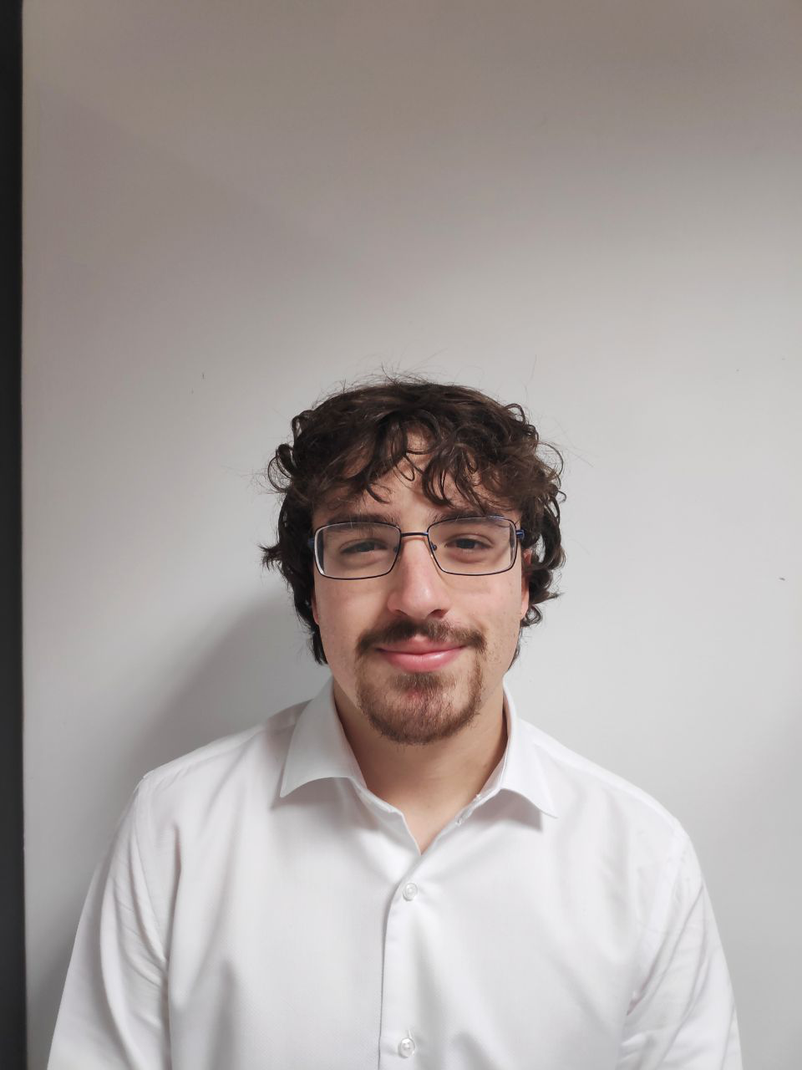
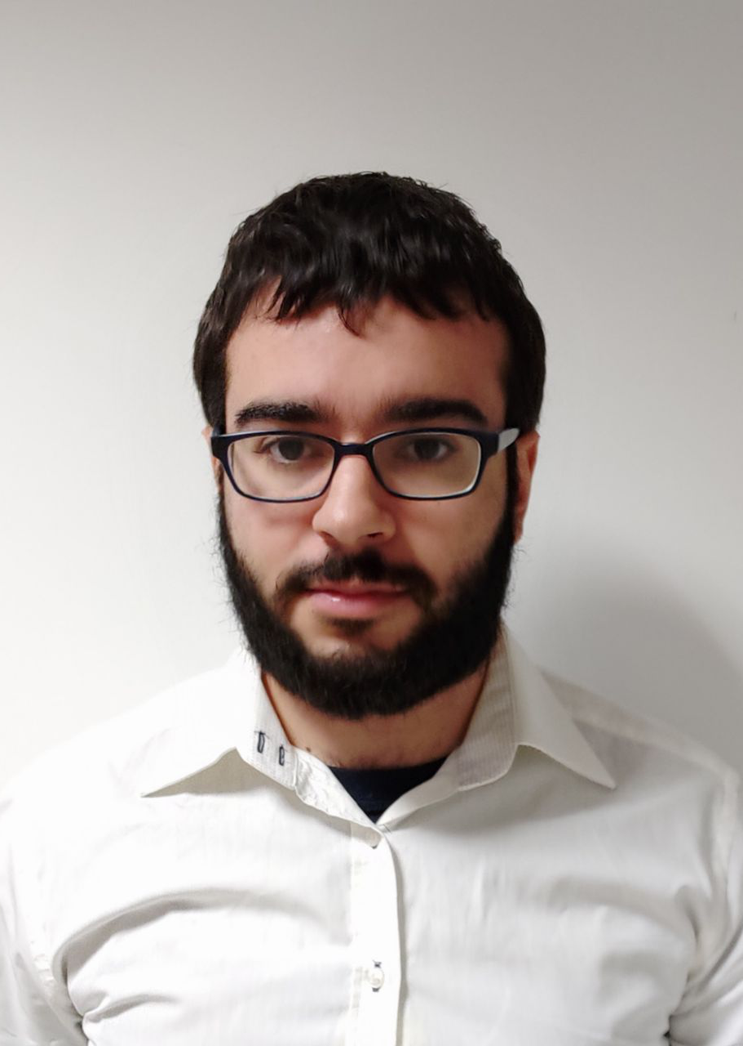
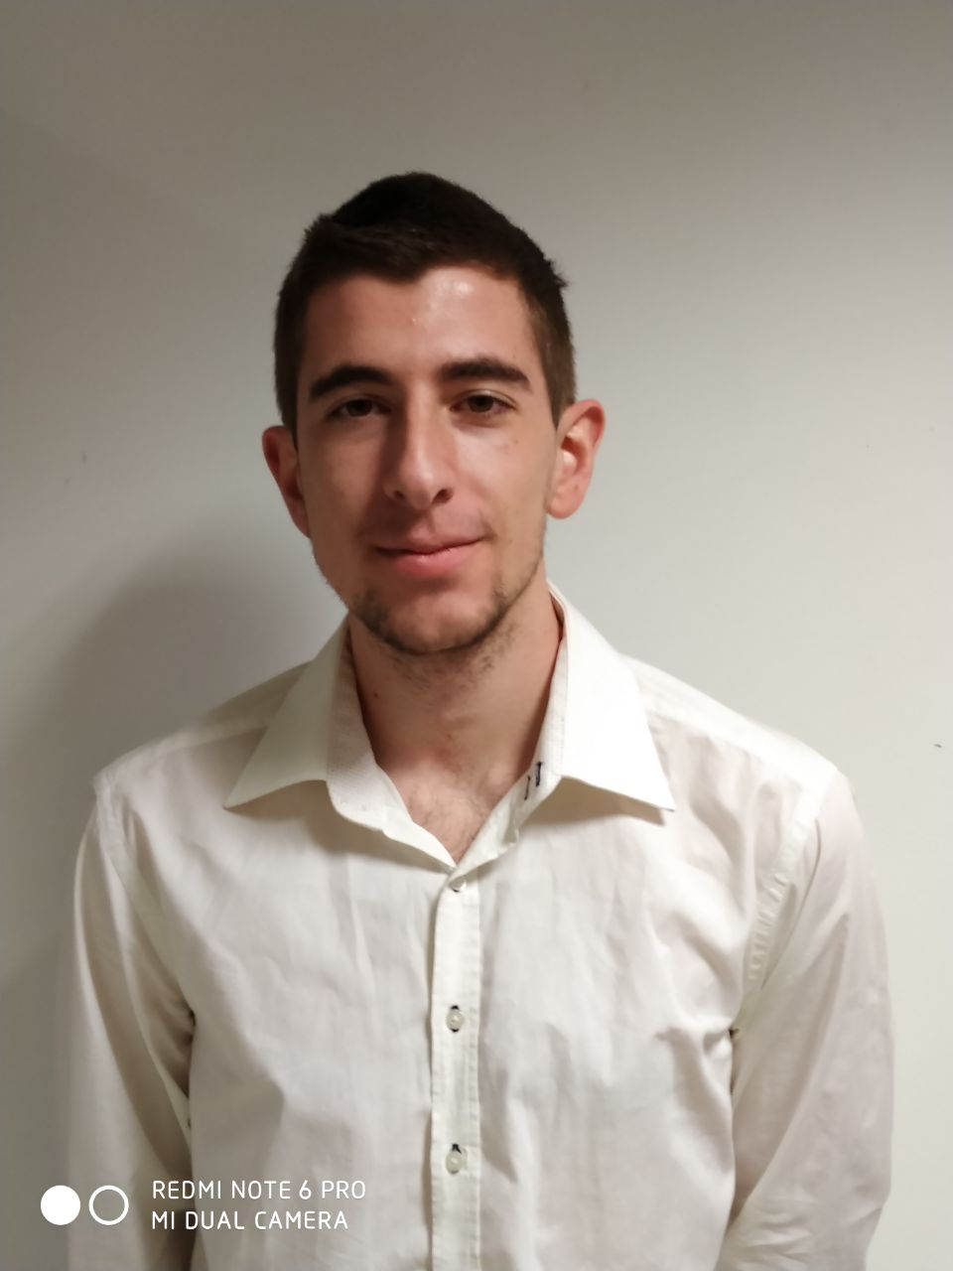
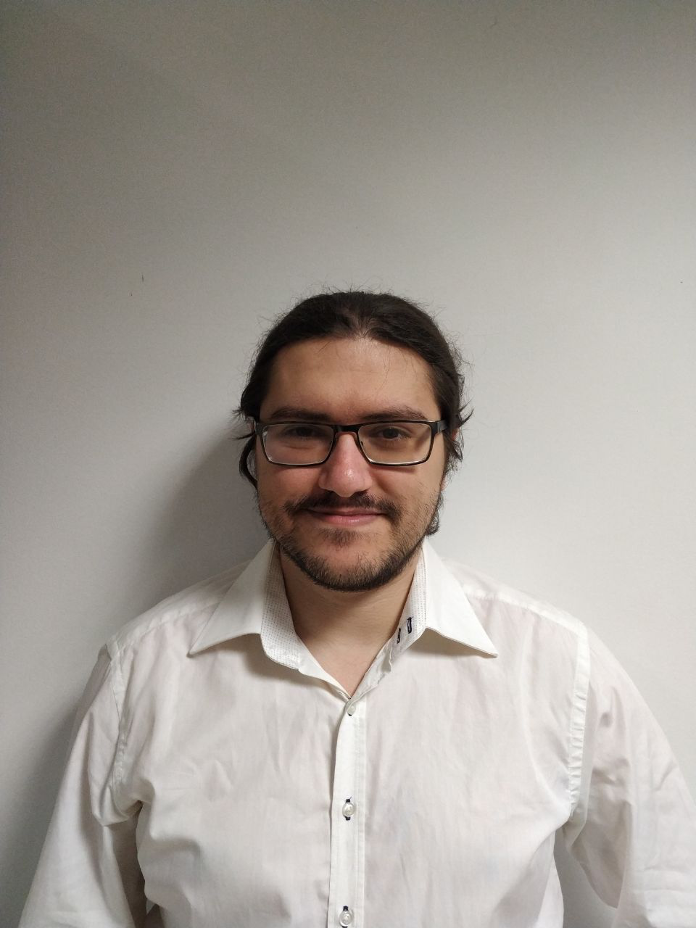
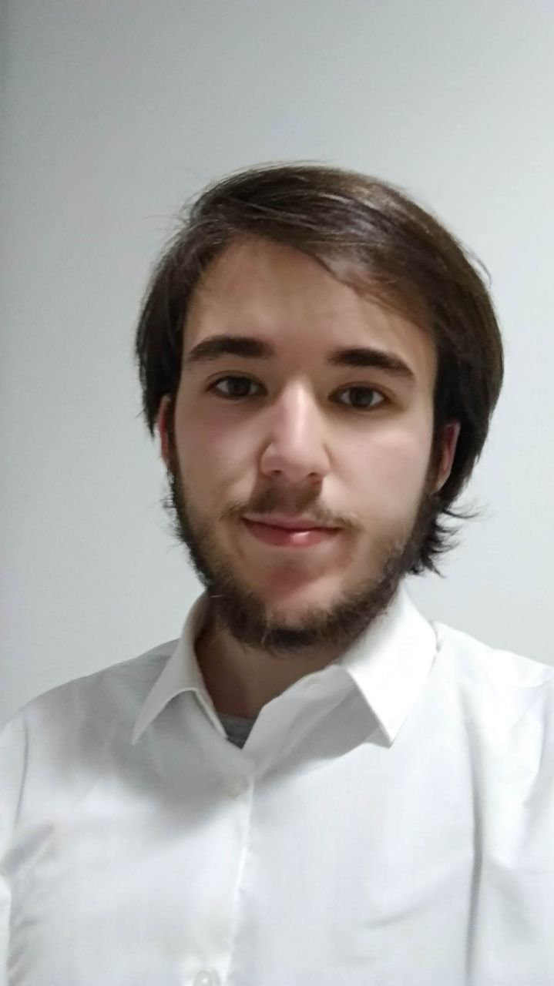
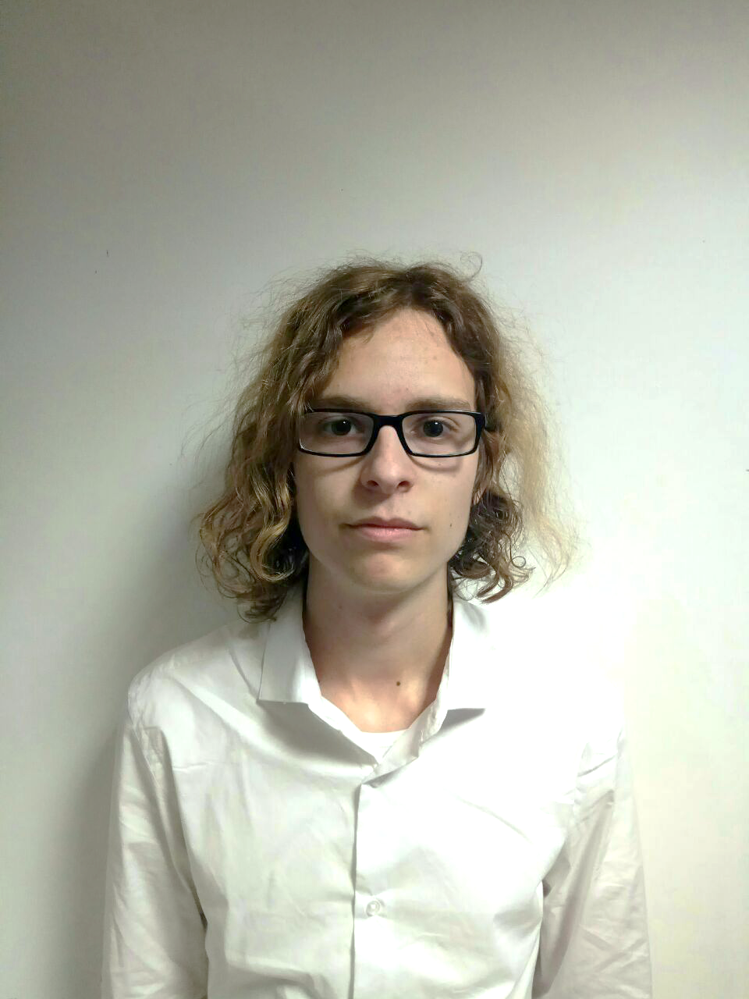

Development plan
1 | 2 | 3 | 4 | 5 | 6 | 7 | 8 | 9 | 10 | 11 | 12 | 13 | 14
Management and testing
All the team
Parallel task – all project
5.5
/
10
each

Slide 57

Development plan
1 | 2 | 3 | 4 | 5 | 6 | 7 | 8 | 9 | 10 | 11 | 12 | 13 | 14
Event tags
Minor messaging fix
Fco. Javier de la Fuente
100%
5
/
5

Slide 58
Development plan
1 | 2 | 3 | 4 | 5 | 6 | 7 | 8 | 9 | 10 | 11 | 12 | 13 | 14
CSS work and fixes
Alejandro Monteseirín
100%
7
/
10

Slide 59
Development plan
1 | 2 | 3 | 4 | 5 | 6 | 7 | 8 | 9 | 10 | 11 | 12 | 13 | 14
Minor game viewer fix
Conference day poster
Pablo Pazo
100%
4
/
5

Slide 60
Development plan
1 | 2 | 3 | 4 | 5 | 6 | 7 | 8 | 9 | 10 | 11 | 12 | 13 | 14
Sub view enhancements
User deletion check
Premium CV visibility
Miguel Santos
100%
7
/
7

Slide 61
Development plan
1 | 2 | 3 | 4 | 5 | 6 | 7 | 8 | 9 | 10 | 11 | 12 | 13 | 14
Advertisements
Presentation tasks
Mario Bizcocho
100%
7
/
7.5

Slide 62
Development plan
1 | 2 | 3 | 4 | 5 | 6 | 7 | 8 | 9 | 10 | 11 | 12 | 13 | 14
QA, supporting tasks
CV minor fix
Antonio Arenas
100%
6
/
6

Slide 63
Development plan
1 | 2 | 3 | 4 | 5 | 6 | 7 | 8 | 9 | 10 | 11 | 12 | 13 | 14
Challenge responses
Internationalization
Iván Pérez
100%
6
/
6

Slide 64
Development plan
1 | 2 | 3 | 4 | 5 | 6 | 7 | 8 | 9 | 10 | 11 | 12 | 13 | 14
Conference day
Documentation
Jorge Manuel Molina
100%
6
/
6

Slide 65
Contents
What is Aim Games?
Demonstration
Where we are
Team composition
Issues faced
Next steps
Productivity control
Advertisements

Slide 66
Next steps
Finishing touches
Make final investor presentation script
World producto launch

Slide 67

Thank you for your time!
If I have seen further it is by standing on the shoulders of Giants
- Isaac Newton
Summer in Mara (Chibig, Valencia, 2019)
Any questions?
Notes:
Grupo 7

